Slide 1


Welcome
By Pavan Kumar

Slide 2
What is Algorithm?
An algorithm is a step-by-step procedure to solve a problem.
EX: Preparing a Recipes.
A good algorithm should be optimized in terms of time and space.
Different types of problems require different types of algorithmic-techniques to be solved in the most optimized manner.
There are many types of algorithms but the most important and the fundamental algorithms that you must know will be discussed in here.

Slide 3
Contents:
Types of Algorithms
1. Brute Force Algorithm:
Ex: Search of a Number
2. Recursive Algorithm:
Ex: Factorial of a Number.
3.Divide and Conquer Algorithm:
Ex: Merge sort
4.Dynamic programming algorithms
Ex: Tower of Hanoi
5.BackTracking Algorithm:
Ex: N-Queens Problem

Slide 4
Brute Force Algorithm:
An Algorithm that tries a different no of patterns to solve a Problem , This is the most basic and simplest type of algorithm More technically it is just like Iterating every possibility available to solve that problem.
EX:A Common Example of a brute force algorithm is a security threat attempts to Guess a password.
If there is a lock of 4-digit PIN. The digits to be chosen from 0-9 then the brute force will be trying all possible combinations one by like 0001, 0002, 0003, 0004, and so on until we get the right PIN.
In the worst case, it will take 10,000 tries to find the right combination.

Slide 5
Recursive Algorithm:
This type of algorithm is based on recursion. In recursion, a problem is solved by breaking it into subproblems of the same type and calling own self again and again until the problem is solved with the help of a base condition.
Ex: Factorial of a number.

Slide 6
Divide and Conquer Algorithm:
In Divide and Conquer algorithms, the idea is to solve the problem in two sections, the first section divides the problem into subproblems of the same type. The second section is to solve the smaller problem independently and then add the combined result to produce the final answer to the problem.
Divide and Conquer is an algorithmic paradigm. A typical Divide and Conquer algorithm solves a problem using following three steps.
Divide: Break the given problem into subproblems of same type.
Conquer: Recursively solve these subproblems
Combine: Appropriately combine the answers
Ex: Binary Search, Merge Sort, Quick Sort etc..

Slide 7
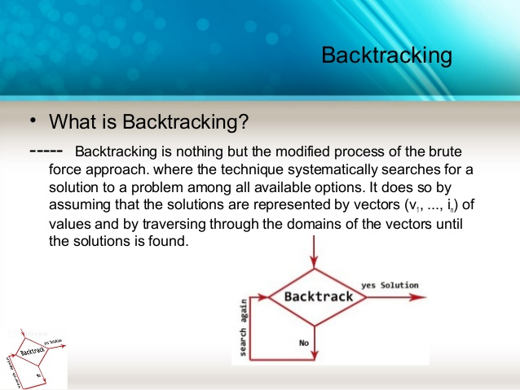
Backtracking:
Backtracking can be defined as a general algorithmic technique that considers searching every possible combination in order to solve a computational problem.
Ex: N-Queen Problem, Sudoku.

